Slide 1


GSA Connects 2025
Attendee Toolkit

Slide 2

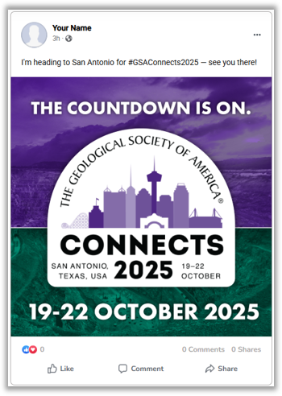
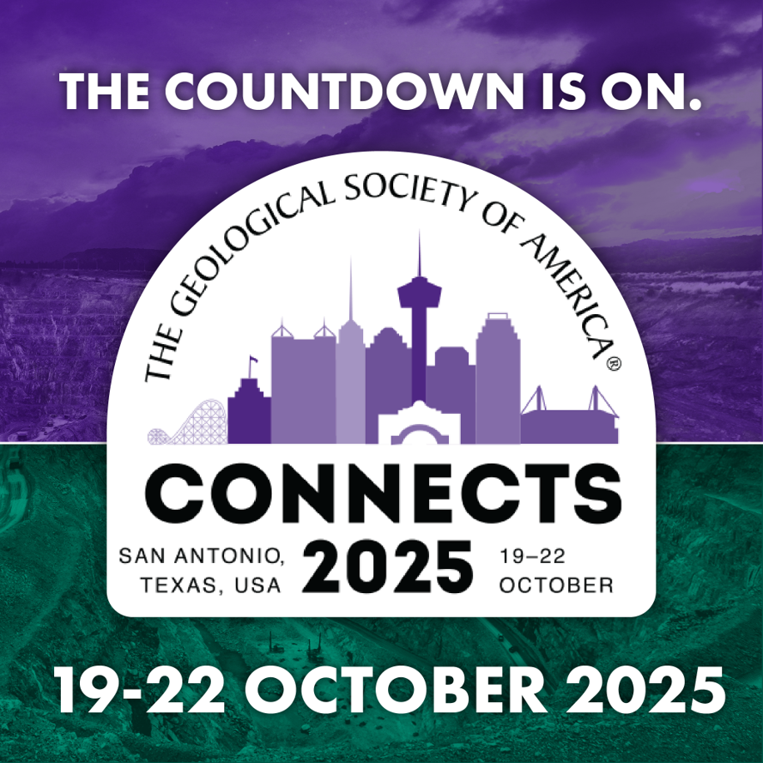
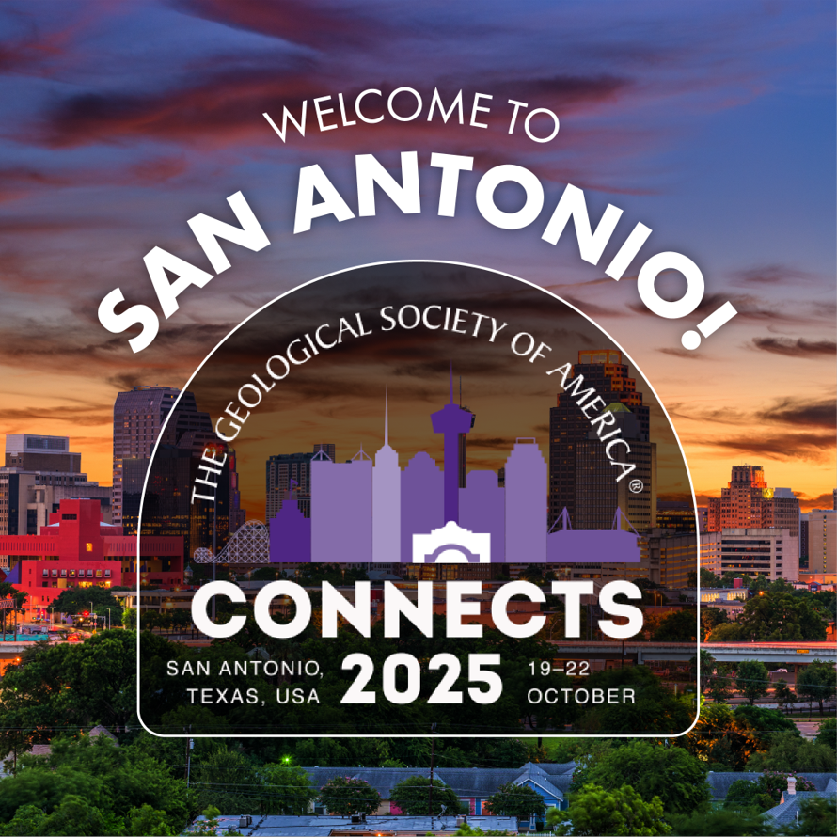

Social Post Graphics
Share your attendance at GSA Connects 2025 with your social circle!
Download these graphics to post on your social media and share your Connects 2025 participation with friends and followers.
Need caption ideas? See the next slide for suggestions!

Slide 3
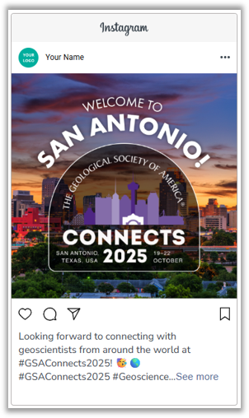
Social Post Captions
GSA Connects 2025 | Social Post Caption Ideas
Just a few days to go until #GSAConnects2025 — see you there! 👋
Geoscience, sunshine & San Antonio: here we come! #GSAConnects2025 🌎
Packing my bags for #GSAConnects2025 — ready to learn, connect, and explore!
Can’t wait to meet fellow geoscientists and share ideas at #GSAConnects2025!
So excited to join the geoscience community at #GSAConnects2025!
See you in San Antonio for #GSAConnects2025! Let’s rock this year’s meeting!🪨
Suggested tags:
#GSAConnects2025, #GSA, #Geoscience, #Geology, @geosociety

Slide 4

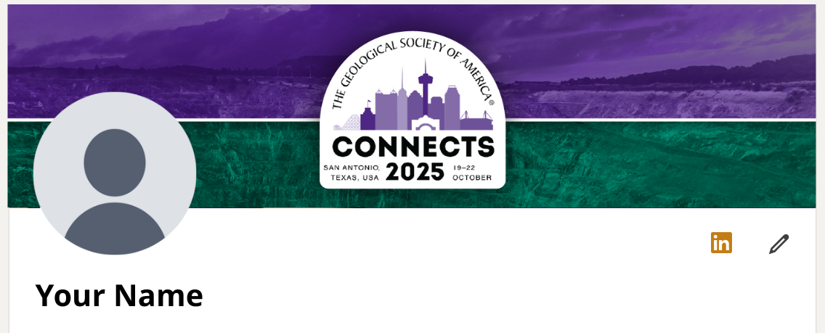
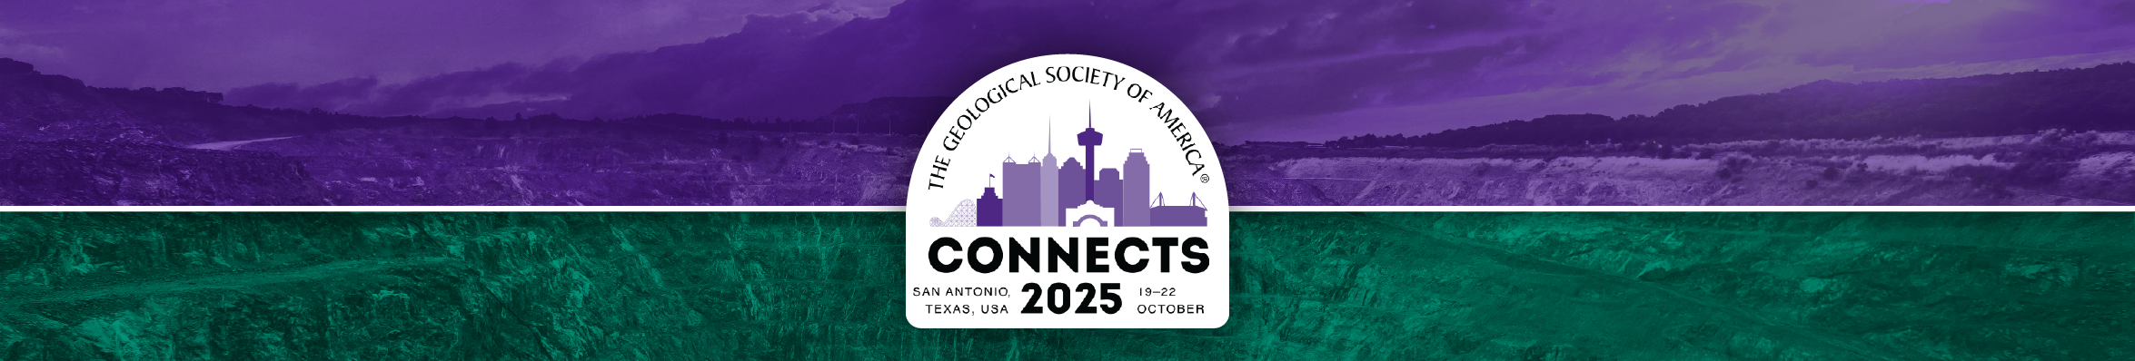
Social Banner Graphics
Use these banner graphics to show off your Connects 2025 participation!
Download these banners and add them to your Facebook, LinkedIn, X, or Instagram profiles.
1709 x 750
Facebook banner
2530 x 398
LinkedIn banner

